Slide 1
www.colorado-hydrogen.org
Monthly Meeting
17 December 2024

Slide 2


CHN Five Year Anniversary!
The Network Connections
Over 90 Companies
H₂ Advocacy
Agencies
ARO Industries
Barber-Nichols
BayoTech
Black and Veatch
Blackhorn
BNG Clean Fuel Corporation
BPX
Brendle Group
Coffman Engineers
Colorado AAA
Cummins
Czero Solutions
Danfoss Editron
Daroga Power
Eberspaecher
EDF Renewable
ElectroMech
ElektrikGreen
Element One
Element One Energy
Emerson
Energy Crafters
Eneus Energy
EPC
Eroe Power Systems
FMI Capital Advisors
Free Radical Ventures LLC
Fuel Cell Energy
Green Planet Lab
GKN
Greencore Global
Hatch
H2 Aerospace
H2 Power, Inc
HDR
Hoaco Automation Technology LLC
Holland and Hart
Horizon Educational
Hydrogene Helix, SAS
Hydrostar USA
HyET Hydrogen
Independence Hydrogen
Innosphere
Interlock Consulting
Kempy Energetics
Keysight
Krueger Transit Consulting
Kubagen Ltd.
Lancer
Magnum Development
Malmö Vimmerby
McClure Engineering
Mettler Toledo Thornton
Millennium Reign Energy LLC
Natural Hydrogen EnergyNel Hydrogen
NextEra Energy
Nikola
NovoHydrogen
Pentad Associates, Inc.
Petronas
PG&E
Pi Innovations
PlugPower
Proteum Energy
Raven Ridge Resources
Rentricity
Resato
Risktec Solutions
RTD Denver
RWDC Industries
Saoradh
Seaton Hill CFO Services
Seven Generations
Sharper Energy Technologies
Spirae, LLC
Starfire
Steelhead - A Vestas Company
Steelhead Composites Inc.
Suburban Propane Partners, L.P.
SuperTurbo
Symbios Technologies
Tarafert
Verdek
Wärtsilä North America
Western Resources
Woodward Inc
WSP
X3Energy
Xavier d'Hubert Consulting
Asia-Pacific Hydrogen Association
Bonneville Environmental Foundation
BRIGHT Energy Innovators
California Hydrogen Business Council
California Hydrogen Coalition
Canadian Hydrogen & Fuel Cell Association
CCIA
Clean Cities
Drive Clean Colorado
Northern Colorado
Climate Reality Project
Colorado Cleantech Industries Association
Colorado Energy Research Collaboratory
CTE (Cent for Transportation & Environment)
Energy Independence Now
Fuel Cell and Hydrogen Energy Association
Fuel Cell India Magazine
Green Hydrogen Coalition
H2B2
Hydrogen Fuel Cell Partnership
Renewable Hydrogen Alliance
Renewable Hydrogen Fuel Cell Collaborative
Stationary Fuel Cell Collaboratory
US Hydrogen Alliance
CDOT
Colo Div Oil & Public Safety
Colorado Energy Office
DoE H₂ & Fuel Cell Tech Off.
DoE Vehicle Technology Office
NIST
NREL
Regional Air Quality Council
Utilities
Colorado Springs Utilities
Fort Collins Utilities
Platte River Power Authority
Tri-State Utility
Xcel Energy
Universities
California State at Los Angeles
Cleveland State University
Colorado School of Mines
Colorado State University

Slide 3
Agenda
Geologic Helium & Hydrogen Conference – Denver
New paper on Geologic Hydrogen
CHN-sponsored fleet of passenger FCEV’s
CHN 5-year anniversary
  The state of hydrogen in Colorado and beyond
  The past, today and the future

Slide 4

Geologic Helium & Hydrogen Conference
April 9-10 in Denver
Lectures and Exhibit Hall
CHN participation
  Booth
  Abstract submitted for a presentation
  “Building the Hydrogen Market”
Presented by the Rocky Mountain Association of Geologists
Info at www.rmag.org
Hydrogen From Geology is Likely the Lowest-Cost Source

Slide 5
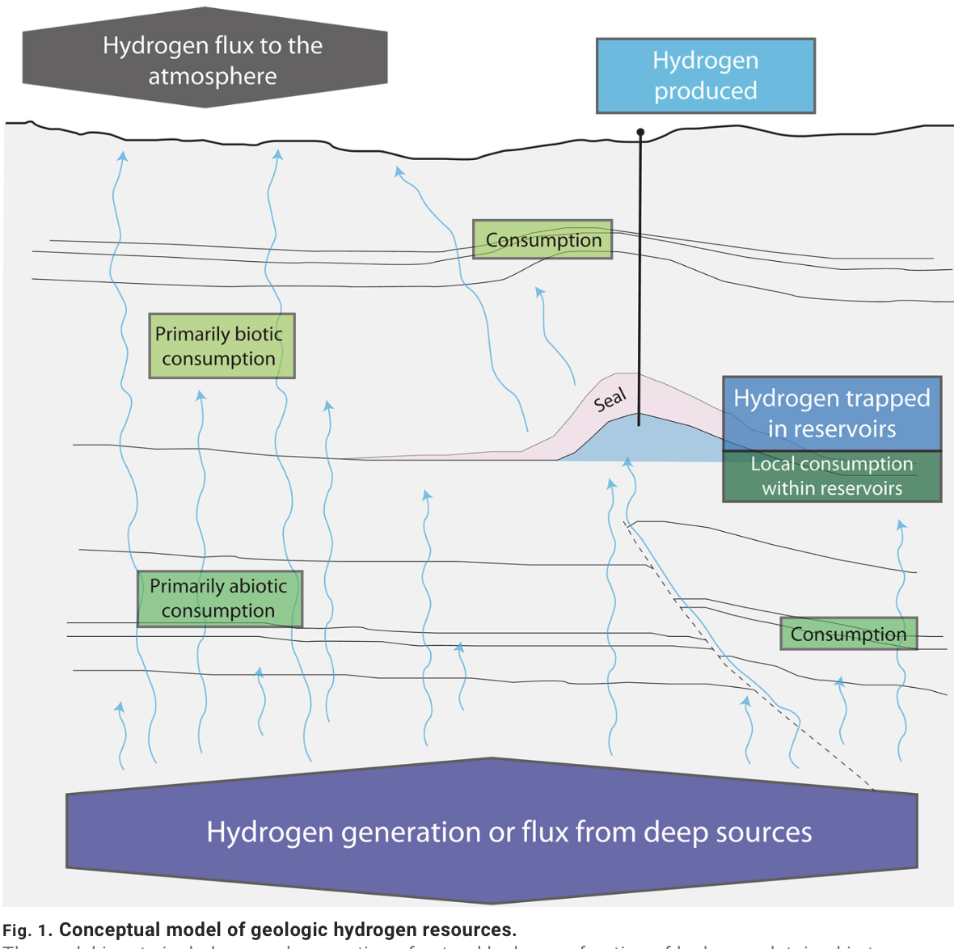
New Paper on Geologic Hydrogen
Dec 13th
From Geoff Ellis
& Sarah Gelman, USGS
“Model predictions of global geologic hydrogen resources”
The predicted amount of recoverable hydrogen “contains more energy than all proven natural gas reserves on Earth”
See: tinyurl.com/GeoH2Paper

Slide 6
Sponsored Fleet of
Passenger FCEV’s

Slide 7
Sponsored Fleet of Passenger FCEV’s
CHN intends to sponsor a fleet of passenger FCEV’s in the metro area once the first hydrogen fuel station is operating
Purpose of the fleet program
  Generate hydrogen sales to help with fuel station ROI
  Advertising and public awareness
    Vehicles would display decals promoting hydrogen
    Word of mouth and media coverage
  Operators would consist of enthusiasts & early adopters
Fleet deployment would be in advance of FCEV sales and service
  Automakers reluctant to start selling Fuel Cell EV’s or stand-up service until a “critical mass” of fuel stations are in operation (around 5)
CHN is continuing to collect names of interested participants

Slide 8



Passenger Fuel Cell Electric Vehicles (FCEV)
Toyota
Mirai
Honda
CR-V e:FCEV
Hyundai
Nexo

Slide 9
Honda
CHN connected with Honda at the Saoradh “Hydrogen Mountain Retreat” in Boulder October 1st
Two subsequent telecons have been held with Honda executives proposing the FCEV fleet idea sponsored by CHN
Colorado Hydrogen Network role
  Find, enlist and manage drivers
  Educate drivers about the characteristics of the program
  Educate on the use of the hydrogen fuelers and safety information
Honda role
  Make vehicles available for lease and deliver to Denver area
  Help arrange servicing (local or California)
  Vehicle graphics.
Launch Date: First-half of 2026

Slide 10
Colorado Hydrogen Network
Five-Year Anniversary

Slide 11
The Colorado Hydrogen Network
Formed in December 2019
  By Brian DeBruine, Dr. Bryan Willson, Frans Westenbrink
  Launched via a charter meeting with NREL, CDOT, DoE, Energy Office, CSU & EPC
  Non-profit 501(C)(6)
Motivation to start the organization
  To help deploy Clean Energy where help is most needed
    Hydrogen
      Help start the hydrogen market where none currently exists
        By bringing together suppliers, users and infrastructure
      Transportation – The need for hydrogen vehicles continues to be misunderstood
    Deploy a Clean Energy Hub (ecosystem)
      Supply, users, infrastructure
      Electricity, hydrogen, biofuel.

Slide 12
Colorado Hydrogen History 2019 - 2021
Dec 2019 | CHN launched via charter meeting with NREL, CDOT, DoE, Energy Office, CSU & EPC Website launched
May 2020 | HydrogenNowCast podcast launched
Jul 2020 | Colorado signs Multi-State MD/HD ZEV MOU
Sept 2020 | CHN & NREL achieve hydrogen fuel station donation to CSU Powerhouse
Dec 2020 | New Day Hydrogen launched to deploy hydrogen fuel stations
May 2021 | Colorado passes SB21-260 “Sustainable Transportation System” to form Clean “Enterprises” with funding for ZEV and hydrogen fueling
Oct 2021 | Colorado Energy Office publishes “Opportunities for Low-Carbon Hydrogen in Colorado: A Roadmap”

Slide 13
Colorado Hydrogen History 2022 - 2024
Feb 2022 | Western Inter-States Hydrogen Hub (WISHH) formed
Aug 2022 | Federal Inflation Reduction Act With Production and Investment Tax Credits, Vehicle Credits and Fuel Station Credits for Hydrogen
Nov 2022 | Federal Infrastructure Investment and Jobs Act With $9.5B for H2 including Hydrogen Hub Funding Colorado OEDIT awards $250k grant to New Day Hydrogen for H2 fuel stations and vehicle support
May 2023 | Colorado passes HB23-1281 “Advance the Use of Clean Hydrogen” production tax credit of $1 per kg
Jan 2024 | US Federal Highway Administration awards $9M grant to CSU and New Day Hydrogen to deploy three hydrogen fuel stations
Oct 2024 | CHN hosts First Annual Colorado Hydrogen Day

Slide 14

HydrogenNowCast Highlights
33 – Methanol as a Hydrogen Carrier
36 – AAA and New Day Hydrogen Hydrogen
43 – Hydrogen Piston Engines with Cummins
51 – Practical Direct-Air Carbon Capture with Algae
34 – Hydrogen for Hydrogen Skeptics
31 – Comparing EV Fueling and Battery Charging at Scale
29 – Resolving the Hydrogen Color Chaos
26 – Which EV Would Einstein Buy?
1 – Fundamentals of Fuel Cell EV's & Hydrogen Fueling
3 – The NREL episode
11 & 46 – Home Hydrogen Generators with ElektrikGreen
13 – Hydrogen From Petroleum Wells with Proton H2
18 – Interview with New Day Hydrogen
20 – Addressing Environmental Criticisms of Hydrogen
4 - Ammonia as a Hydrogen Carrier with Starfire Energy

Slide 15
HydrogenNowCast Highlights
74 – Element One low-cost hydrogen detectors
75 – 45V PTC and the fallacy of temporal matching
79 – Where will we use hydrogen?
80 – DOT Grant for three hydrogen fuel stations
82 - Natural Hydrogen wells with Geoff Ellis USGS
85 – PlugPower
87 - TFL Podcast
58 – Natural Gas to Hydrogen and Solid Carbon with Modern Electron
61 – Natural Hydrogen Wells with Natural Hydrogen Energy
64 – Geothermal Energy to Hydrogen with H2 Synergy
69 – Hydrogen for light-duty vehicles
71 – Deploying FCEV’s outside California
70 – CO2 Direct air capture using algae
63 – New Electrolyzer Catalysts with H2U Technologies

Slide 16
The CHN Website Contents
Calendar (please send us your events)
Initiatives
  About the Colorado H2 Fuel Station efforts
Members and a diagram of the Network
Resources
  Links to Colorado State initiatives and incentives
  Tech briefs (next slide)
Podcast show notes
About CHN

Slide 17


Tech Briefs on the Website
Does Making Hydrogen Use Much Water?
(No)
Hydrogen Wells
(Natural Hydrogen)
Understanding EV’s
(Hydrogen and Battery)
Survey of US Clean Energy Sources
(Hydrogen, geothermal, wind, solar)
Transporting Hydrogen
(Estimated cost breakdown)
Why Do We Need Hydrogen?
(Contrasting molecules and electrons)
Sources of Clean Hydrogen
(Geologic and electrolysis)
Which Energy Form for Use?
(Hydrogen, electricity, biofuel, ammonia)
Hydrogen Safety
(Compared to gas, diesel & battery)
Colors of Hydrogen
(We only need four)

Slide 18



Mission
Our mission is to help start the hydrogen market, by bringing together suppliers, users and infrastructure
HydrogenNowCast
Podcast
Hydrogen
Fuel Stations
Initiatives
Hydrogen Fleets
Geologic Hydrogen
Education and
Workforce Development
Clean Energy Hub

Slide 19
Ongoing Initiatives
Hydrogen fuel stations
  Fuel station donated by Nel to CSU
  Started New Day Hydrogen
    Deploy fuel stations, enlist users, locating commercial H₂ vehicles, securing investors, grants
  Grants
    $250K Colorado OEDIT grant
    $9M US DOT grant
    $946K DoE Vehicle Technology Office (VTO) grant
Podcast
Workforce development
  CHN affiliation with Horizon Educational
  Engaging Colorado high schools and CTE Schools (Career and Technical Education)

Slide 20
New Initiatives
Geologic hydrogen
  Natural hydrogen
  From petroleum reservoirs
    Chemical H₂ extraction
    Biological H₂ extraction
Establish a “Clean Energy Hub”
  Propose a plan for a Colorado Clean Energy Market/Ecosystem
    Supply, transport, dispensing, users, infrastructure, funding
    Solve the “what” (system design) and the “how” (cooperation, timing, funding)
    To focus efforts & guide decisions and investment
  Enlist a Consortium of stakeholder participants
    Companies, universities, agencies
    CCIA, Colorado. Energy & Sustainability Collaboratory
  Seek funding sources, grants and other support.

Slide 21



Clean Energy Hub (Market-Ecosystem)
Electrons
Clean Sources
Convert–Transport–Store
Users
Wind
Solar
Ammonia
Electricity
Electric Grid
Convert
Data Centers
Geothermal
Biofuel
Hydrogen
Hydroelectric
Transportation
Molecules
Industry
Tanker
Transport
Pipeline
Hydrogen Wells
Aviation
In-Situ Hydrogen Generation (ISHG*)
Building Heat
Gas
Store
Battery
Maritime
Biomass & Algae
Liquid
Agriculture
*TM ProtonH2.com

Slide 22
Suitable Energy Forms for Uses
Use | Electricity | Hydrogen | Biofuel | Key Discriminator
Electric Grid | ✔︎
Transportation | ✔︎ | ✔︎ |  | Performance & Convenience
Data Centers | ✔︎ | ✔︎ |  | Cost
Industrial Heat |  | ✔︎ |  | Technical
Aviation |  | ✔︎ Short Range | ✔︎ Long Range | Technical
Building Heat | ✔︎ New Construction |  | ✔︎ Existing | Cost
Maritime |  |  | ✔︎ | Technical

Slide 23
Clean Energy Market / Ecosystem
Electrons
New
Molecules

Slide 24
Hydrogen Must Compete with Fossil Fuels
The Process
Derive the hydrogen prices for parity with gasoline, diesel and natural gas
Based on the competitive price and transport cost, derive the source cost
Define sources that meet this cost.

Slide 25
Gasoline & Diesel Replacement - H₂ Price Target
Goal: Price hydrogen at the same or better cost-per-mile as petroleum
  To entice users to switch from petroleum to hydrogen vehicles
Cost-per-mile is based on vehicle efficiency
  Hydrogen vehicles are more efficient than petroleum . . . but that varies by Class
Energy Economy Ratio (EER)
  Ratio of MPKg-to-MPG
  For similar size and weight vehicles
Class | LD/MD Gas | LD/MD Diesel | HD Diesel Local | HD Diesel Highway
Petrol. $/gal | $3.50 | $4.00 | $4.00 | $4.00
EER | 2.5 | 1.9 | 1.5 | 1.1
Target Price $/kg | $8.75 | $7.60 | $6.00 | $4.40
Price Per kg is Highly Dependent on Vehicle Class and Comparison to Gasoline vs Diesel

Slide 26
Cost-Price Comparison - Transportation
Hydrogen Target Price
Class | LD/MD Gas | LD/MD Diesel | HD Diesel Local | HD Diesel Highway
Petrol. $/gal | $3.50 | $4.00 | $4.00 | $4.00
EER | 2.5 | 1.9 | 1.5 | 1.1
Target Price $/kg | $8.75 | $7.60 | $6.00 | $4.40
Cost for Transport and Generation
 |  |  |  | Cost-Price Comparison
 | ✓ = Price ≥ Cost |  |  | LD/MD Gas | LD/MD Diesel | HD Diesel Local | HD Diesel Highway
 |  |  |  | $8.75 | $7.60 | $6.00 | $4.40
Cost ($/kg) | LH₂ | $4.74 | $4.74 | ✓ | ✓ | ✓ | (✓)
 | LOHC | $6.17 | $6.17 | ✓ | ✓ | (✓)
 | Ammonia | $7.51 | $7.51 | ✓ | ✓
 | Electrolysis | $8.75 | $8.75 | ✓
50-mile delivery | Transport CAPEX debt service ($/kg) | Transport OPEX ($/kg) | Transport Total Cost | H₂ Cost at well | Total Cost ($/kg)
LH₂ Delivered | $2.40 | $2.04 | $4.44 | $0.30 | $4.74
LOHC Delivered | $2.73 | $3.13 | $5.87 | $0.30 | $6.17
Ammonia Delivered | $4.43 | $2.78 | $7.21 | $0.30 | $7.51
On-Site Electrolysis | $4.23 | $4.52 |  |  | $8.75
To Compete With Petroleum
Hydrogen Needs to Cost Less Than 30¢ per kg at the Source

Slide 27
Cost-Price Comparison – Natural Gas
Item | Value (at H2 Source)
CH₄ cost per 1,000 SCF (delivered) | $9.60
BTU per 1,000 SCF | 1,028,000
BTU per kg H₂ (LHV) | 113,727
kg H₂ equiv. to 1,000 SCF CH₄ | 9.04
Price per kg H₂ equiv. to CH₄ delivered | $1.06
Pipeline cost OPEX + ROI | $0.20 to $0.80
Hydrogen must cost per kg at source | $0.86 to $0.26

Slide 28
Hydrogen Cost at the Source
Hydrogen Source | Cost per kg
Electrolysis | $8.75
H₂ from oil wells (chemical extraction) | $0.30
H₂ from oil wells (biological extraction) | TBD (< $0.30)
Natural Hydrogen | TBD (< $0.30)
Geologic Hydrogen May be the Only Competitive Hydrogen Source
Therefore, we need to develop those sources

Slide 29
Take-Aways
Why should a Hydrogen Network care about the entire Clean Energy Ecosystem?
In order for hydrogen to compete with petroleum and natural gas, low-cost sources of hydrogen are required
  That is, Geologic
To develop geologic sources, scale must be considered
  Only large users such as utilities, factories or data centers have the required offtake to meet the ROI for geologic sources
Therefore, we need to consider the entire Clean Energy Hub to develop sources for competitive hydrogen.

Slide 30
Clean Energy Market / Ecosystem
Electrons
Molecules

Slide 31
The State of the Hydrogen Ecosystem
Pluses
Colorado has received funding for 3 hydrogen fuel stations
  Coming early 2025
Colorado funding for hydrogen vehicles and fueling infrastructure
  Clean Transit, Clean Fleet and Community Access “Enterprises”
Federal Inflation Reduction Act with $9B for hydrogen
Minuses
After 5 years (and a donated station) we still don’t have any hydrogen fuel stations in Colorado
Only a few medium-duty hydrogen vehicles available
  Prototypes only
There is no national plan for H₂ fuel station deployment
If we fail to deploy hydrogen vehicles
we will fail to decarbonize transportation

Slide 32
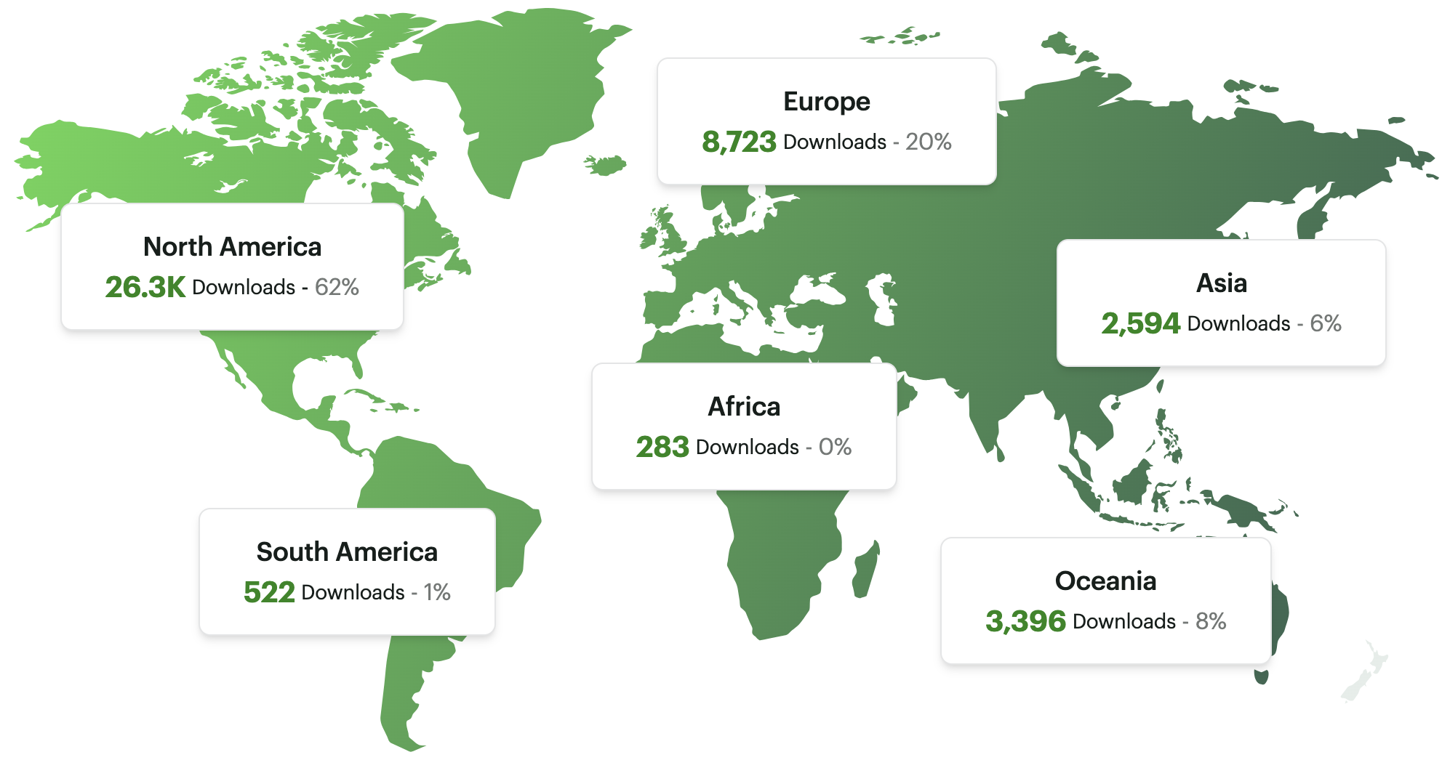


Podcast Update
The HydrogenNowCast
88 episodes
41,900 downloads
Recent episodes
  Hydrogen Mtn Retreat
  TFL Podcast
  Hydrogen transport
  Plug Power
Everyone – Please subscribe and give us a rating!

Slide 33

Happy Holidays to Everyone
and
Best Wishes for a Prosperous 2025

Slide 34


