Slide 1
Monthly Meeting 18 July 2023

Slide 2
Agenda
Hydrogen demand announcement
Overview of Sundyne Corporation
IRA 45V Hydrogen Production Tax Credit (PTC) Update
New CHN Volunteer introduction
CHN 2.0 initiative
  Grant applications
  Open Houses

Slide 3
DoE Considering $1B to Boost Demand for Hydrogen
DoE Office of Clean Energy Demonstrations (OCED) is considering establishing a Demand-side Support Mechanism to boost demand for hydrogen at DOE-supported Regional Clean Hydrogen Hubs
To tackle revenue certainty issues that arise as a result of the natural imbalance between supply scale-up and demand formation in emergent clean energy markets
The mechanism will enable private sector financing
Notice of Intent issued: DE-NOI-0202301
  DoE seeking public input by 5 PM EDT, July 24
“Developing a hydrogen demand-side initiative is critical to ensuring the early commercial viability of a H2Hub given that demand formation for a new energy source typically lags creation of reliable supply”

Slide 4


Sundyne
Michael O’Neil
VP of Hydrogen & PPI Compressor Sales
HQ in Arvada

Slide 5
Sundyne Overview
&
Hydrogen Solutions
June 2023

Slide 6
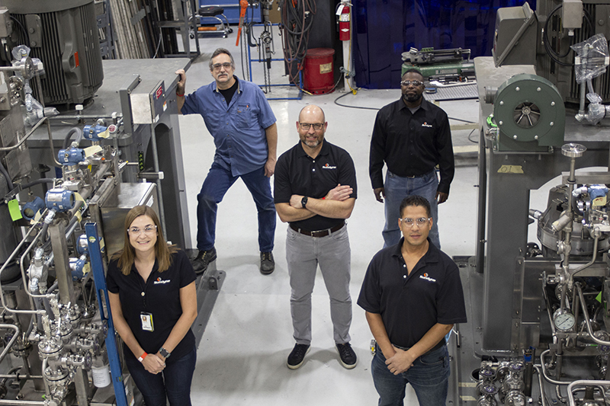
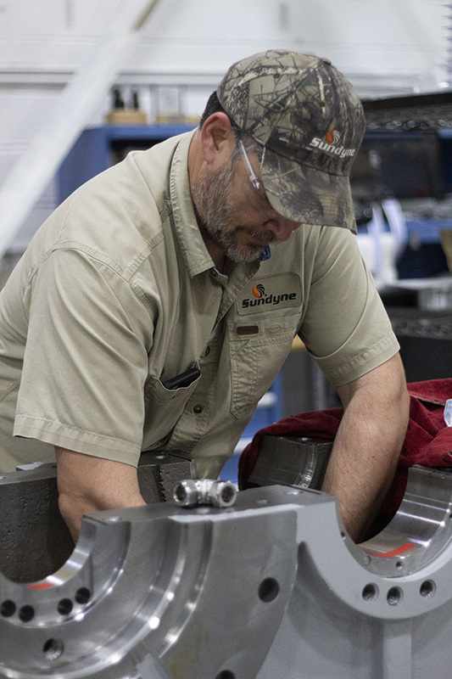
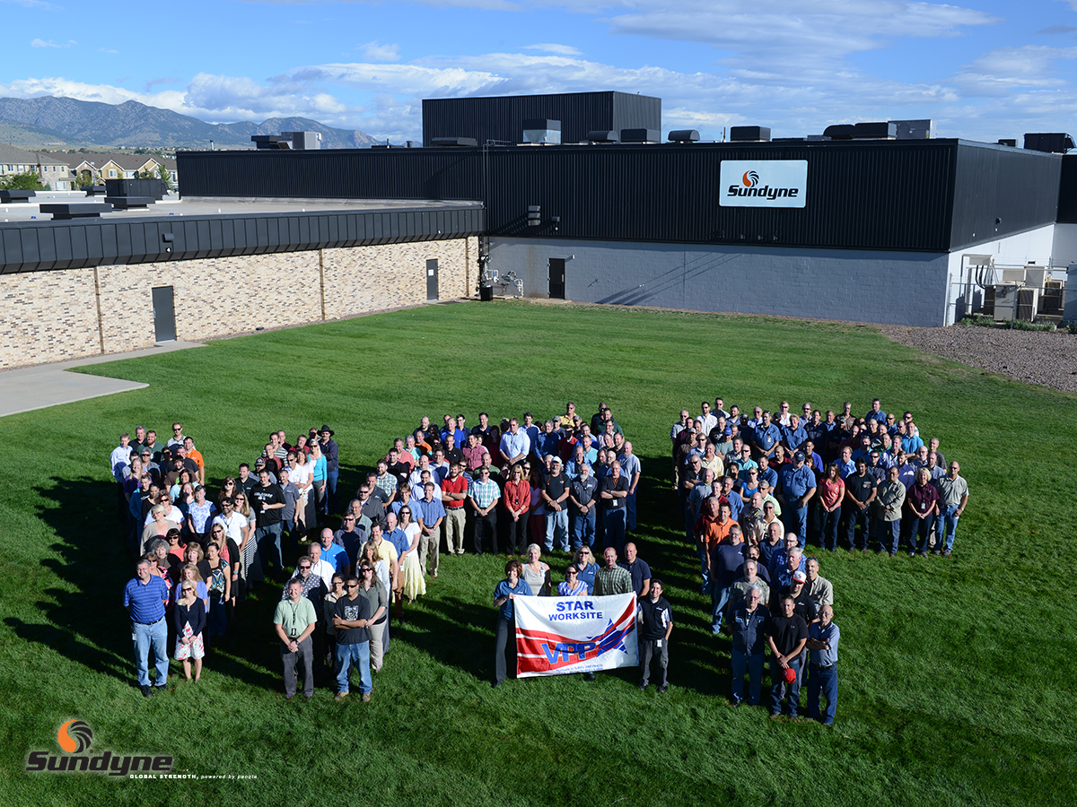

Shared Culture and Mission
Sundyne’s 800 global employees are unified by a common goal and shared values. These core principles are a clear set of shared beliefs that guide our every action.
Statement of Purpose
Sundyne seeks to be recognized worldwide for category defining brands known for quality, reliability, value and performance. We aspire to be seen by our customers as the leading solution when they have mission critical needs in their most demanding and harshest operating environments, where the consequences of failure are severe and where reliability, uptime and durability are paramount.
Core Values
Commitment, pride and ownership
Uncompromising dedication to customers
Sustainability in workplace and community
Highest ethical standards
Quality in all things
Respect, teamwork and communication
Safe, healthy and productive workplace

Slide 7

Sundyne Overview
Sundyne designs, manufactures and services precision-engineered centrifugal pumps, centrifugal and diaphragm compressors around the world and across industries
The Company’s heritage is in low flow, high head pump technology and has grown to a suite of complex flow control solutions
Sundyne traces its roots to the 1950s in the aerospace industry. Those early engineers recognized the value of their initial products outside of aerospace and formed what would later become Sundyne
While the business has evolved, its focus on technology and engineering excellence has not changed, as Sundyne seeks to be a critical partner to its customers for their most demanding applications

Slide 8
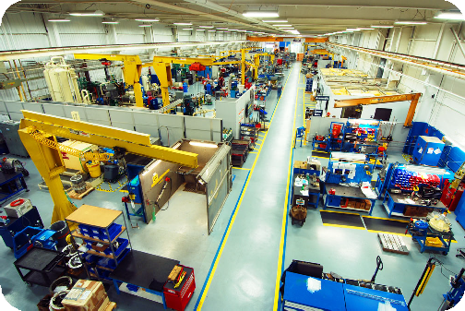
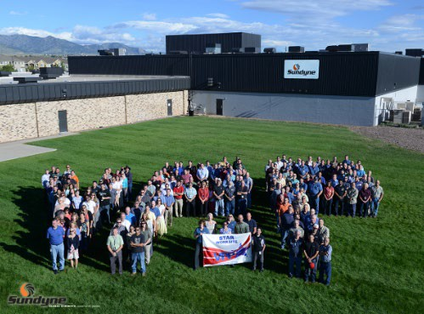
Sundyne Overview
Sundyne engineers, designs & manufactures both Pumps and Compressors
Headquartered in Arvada CO
The Sundyne brand traces its roots back to 1957
Sundyne was acquired by Warburg Pincus and its management team in March 2020
7

Slide 9

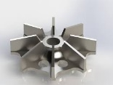
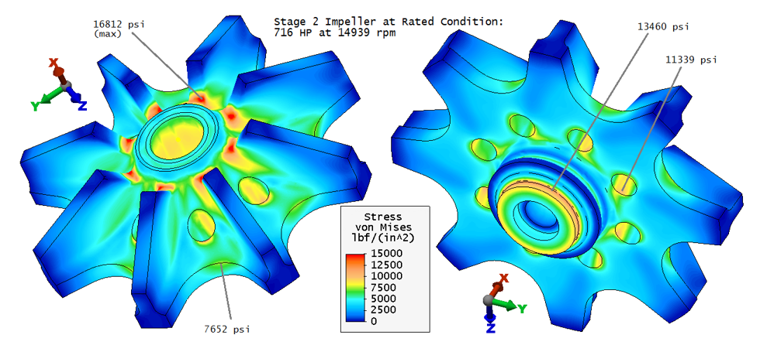


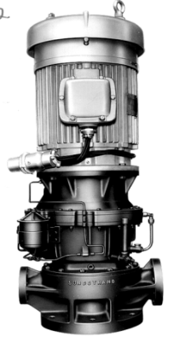
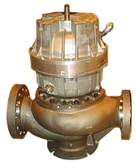
Long-Heritage of Innovation & Growth
Since its origins in the aerospace industry in the 1950s, Sundyne has achieved many “firsts” in fluid handling
  Defined OH6 pump standard for gear-drive pumps and adapted technology to single-stage gas compressors
  Industry pioneer for metallic and polymer-lined magnetic drive sealless pumps
Sundyne has also executed and integrated a number of highly complementary acquisitions to further develop its product portfolio and enhance its offering to its customers
Key Company Milestones
Technological Innovations
1957 | Sundstrand develops the first gear-drive, water injection pump for the Boeing 707 Aircraft
1962 | Sundstrand develops the first high-speed centrifugal pump for Shell
1964 | Sundstrand develops a high-speed gas compressor for Union Carbide
1971 | Sunflo pumps are introduced for industrial applications
1972 | ANSIMAG develops first polymer-lined, magnetic drive, sealless ANSI pump
1995 | Sundstrand acquires HMD Sealless
1998 | Sundstrand acquires ANSIMAG
2004 | Pinnacle compressor introduced
2008 | Sundyne acquires Marelli Bombas in Illescas, Spain
2015 | PPI joins the Sundyne portfolio
High-Speed Technology
Mission-Critical Reliability
40,000+ RPM impeller speed generates high pressure
High-stress applications / advanced metallurgy
1962
First LMV pump
sold to Shell
1964
First LMC compressor
sold to Union Carbide
8

Slide 10
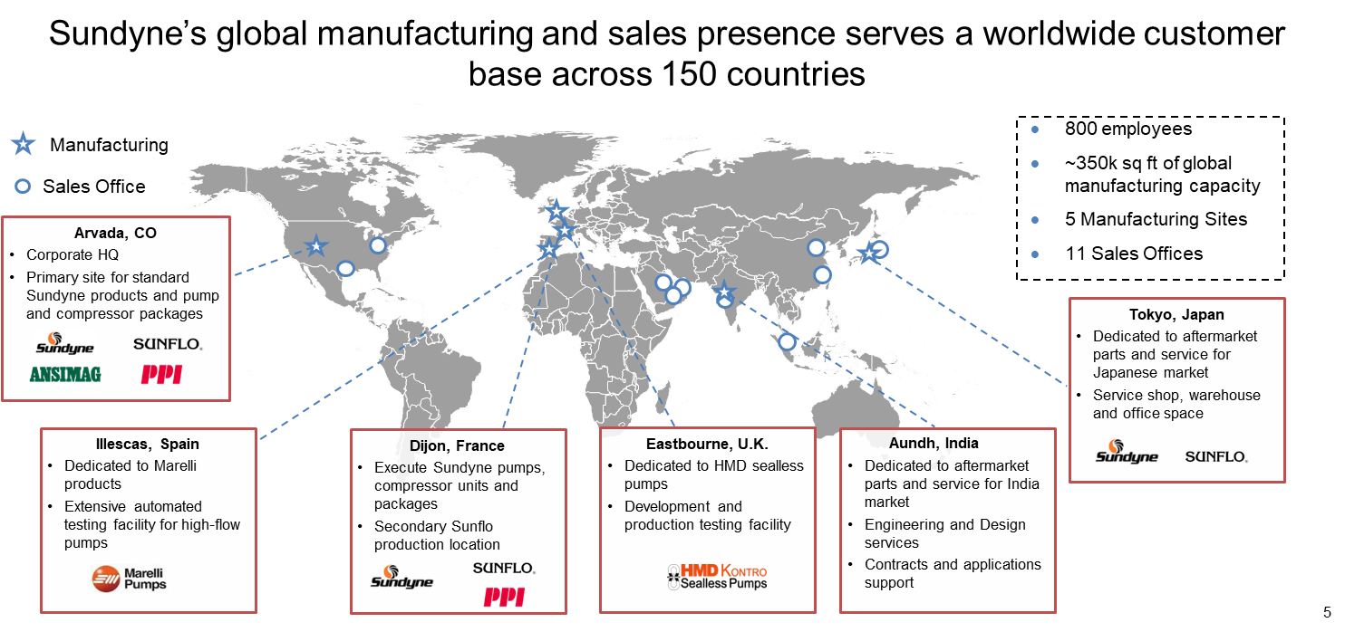
Established Global Presence

Slide 11






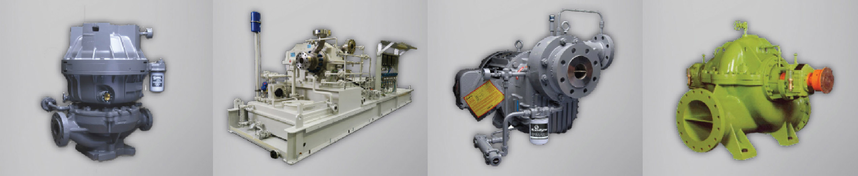
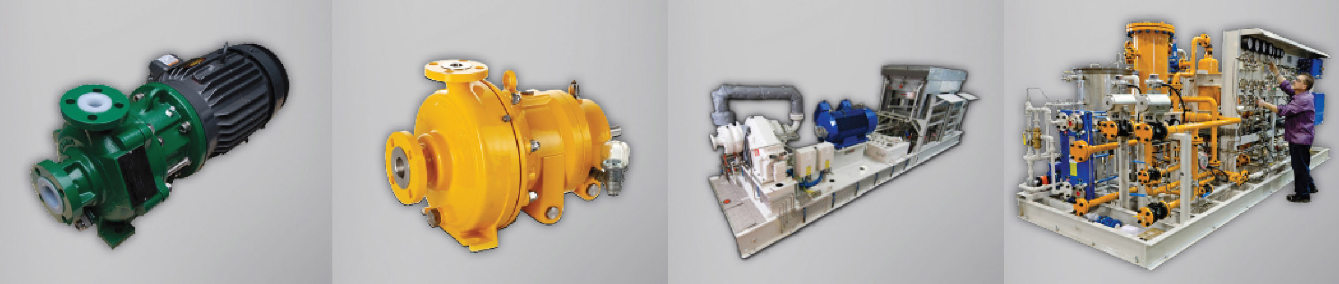
Global Brands
Sundyne’s brands define their categories and hold leading market positions
Each brand targets mission critical applications with harsh or hazardous fluids, where uptime is key, and safe, reliable operations are absolutely paramount
Direct Drive & Integrally Geared Centrifugal compressors and Pumps
Established low-flow, high-pressure category with sale of first high-speed centrifugal pump to Shell in 1962; extended the category to compressors in 1964
Sealless Mag Drive Polymer Lined Pumps
Introduced first polymer-lined ANSI compliant magnetic drive sealless pumps in 1982
Sealless Mag Drive Pumps
Introduced the first sealless, magnetic drive pump in 1946; first to utilize composite zero-loss shell for API applications
Industrial Grade Pumps
First to market with single-stage, gear-drive, low-flow, high-head technology for industrial applications, introduced in 1971
Heavy Duty Pumps
Heavy-duty pumps for severe service hydrocarbon and water applications
Process Gas and Diaphragm Compressors
Advanced compressor packages renowned for highly reliable, leak-free performance that deliver non-contaminating compression of critical gases

Slide 12
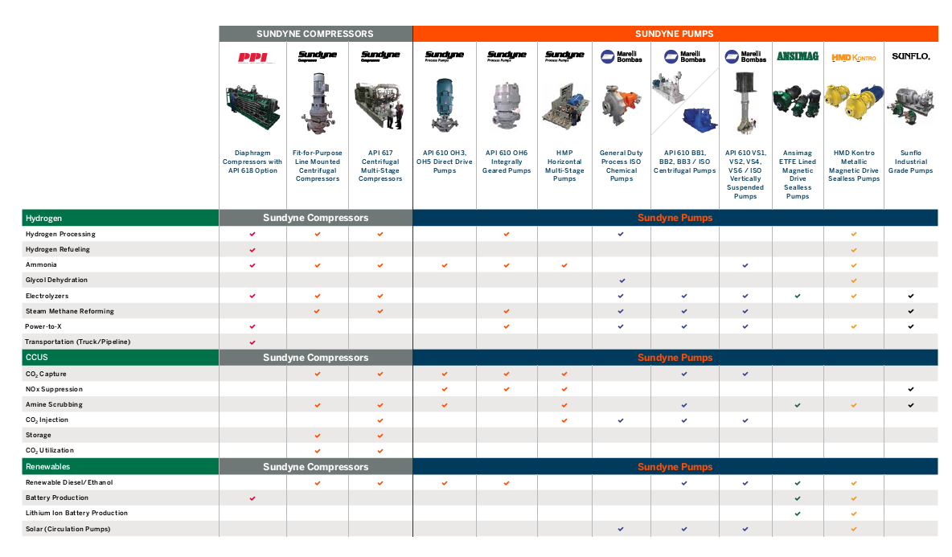
Sundyne Product Portfolio
Pumps & Compressors for Hydrogen and Carbon Capture Applications

Slide 13
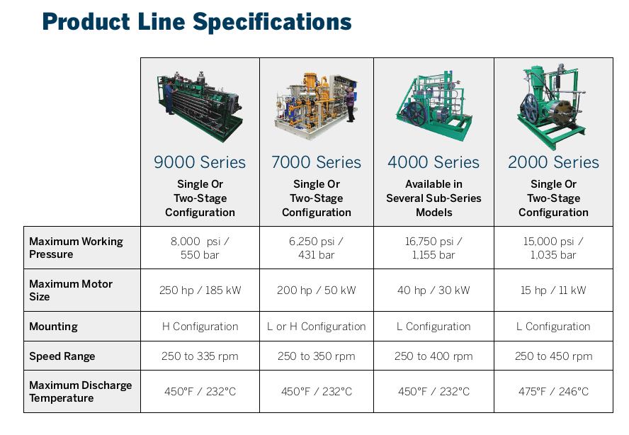

PPI FLOW & PRESSURE RANGE

Slide 14
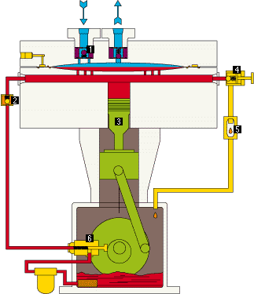
Diaphragm Compressors – How they work?
The diaphragm group completely isolates the gas from the hydraulic system
Process and Hydraulic Head Assembly
Reciprocating Lower Frame
Compressor Valves
Hydraulic Inlet Check Valve
Motor Driven Crankshaft & Piston
Hydraulic the Overpump Valve
Overpump Sight Glass
Hydraulic Injection Pump
13

Slide 15
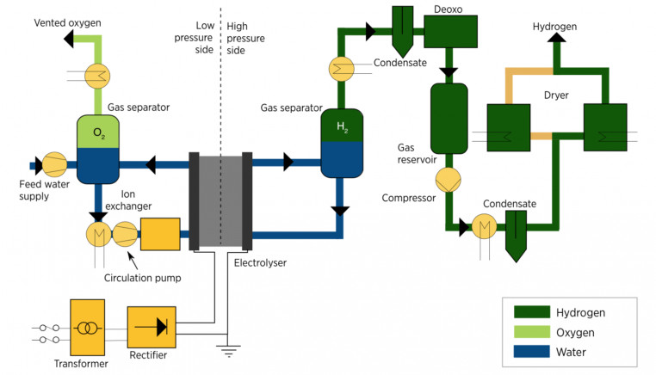
PEM Electrolyzer Technology – How Sundyne Serves the Hydrogen Market
PPI Diaphragm Compressors
Sunflo Industrial Grade Pumps
Sundyne Process Gas Compressors LMC / BMC
Ansimag Sealless Magnetic Drive Plastic Lined Pumps
Sundyne Process Gas Compressors LMC / BMC

Slide 16
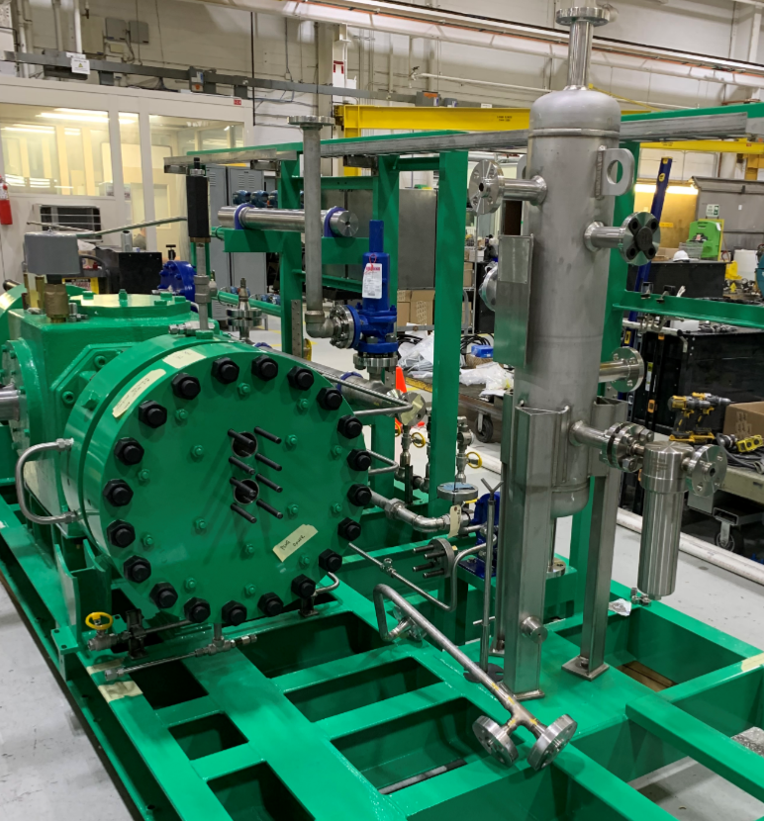
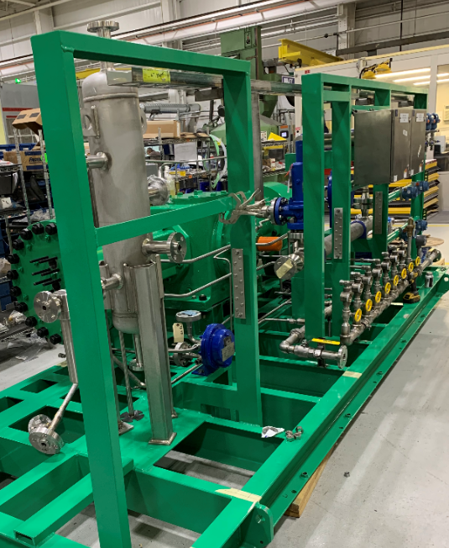
9 Series Hydrogen Compressor Package

Slide 17
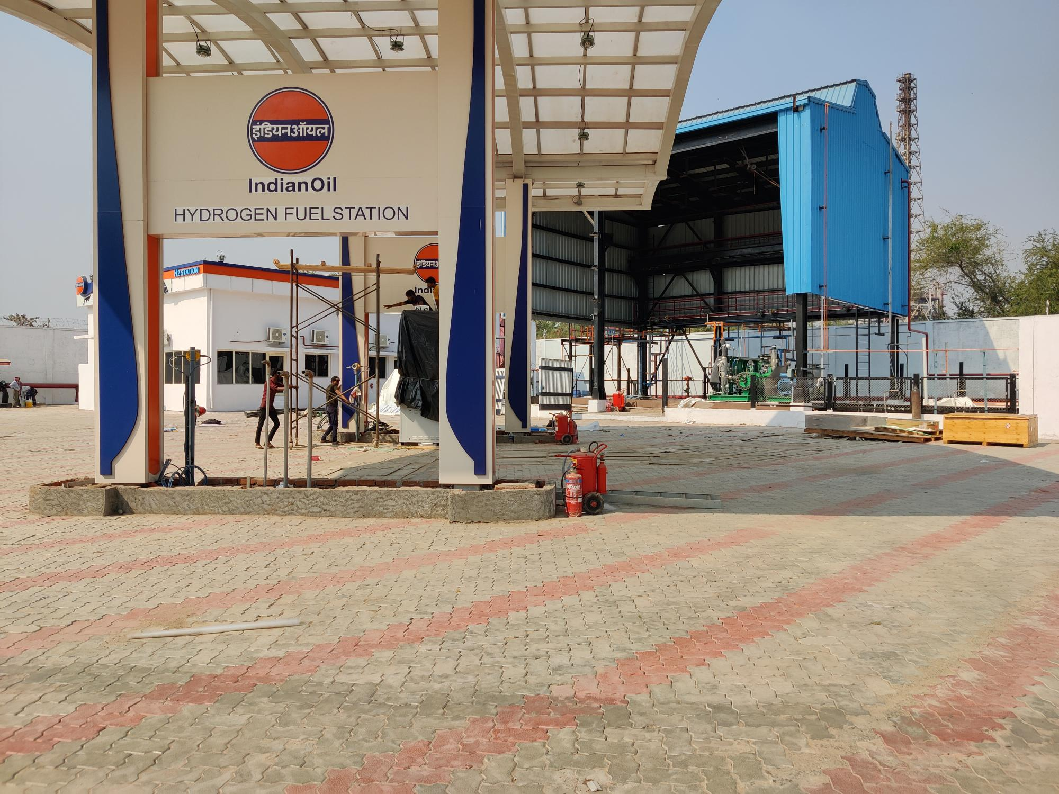
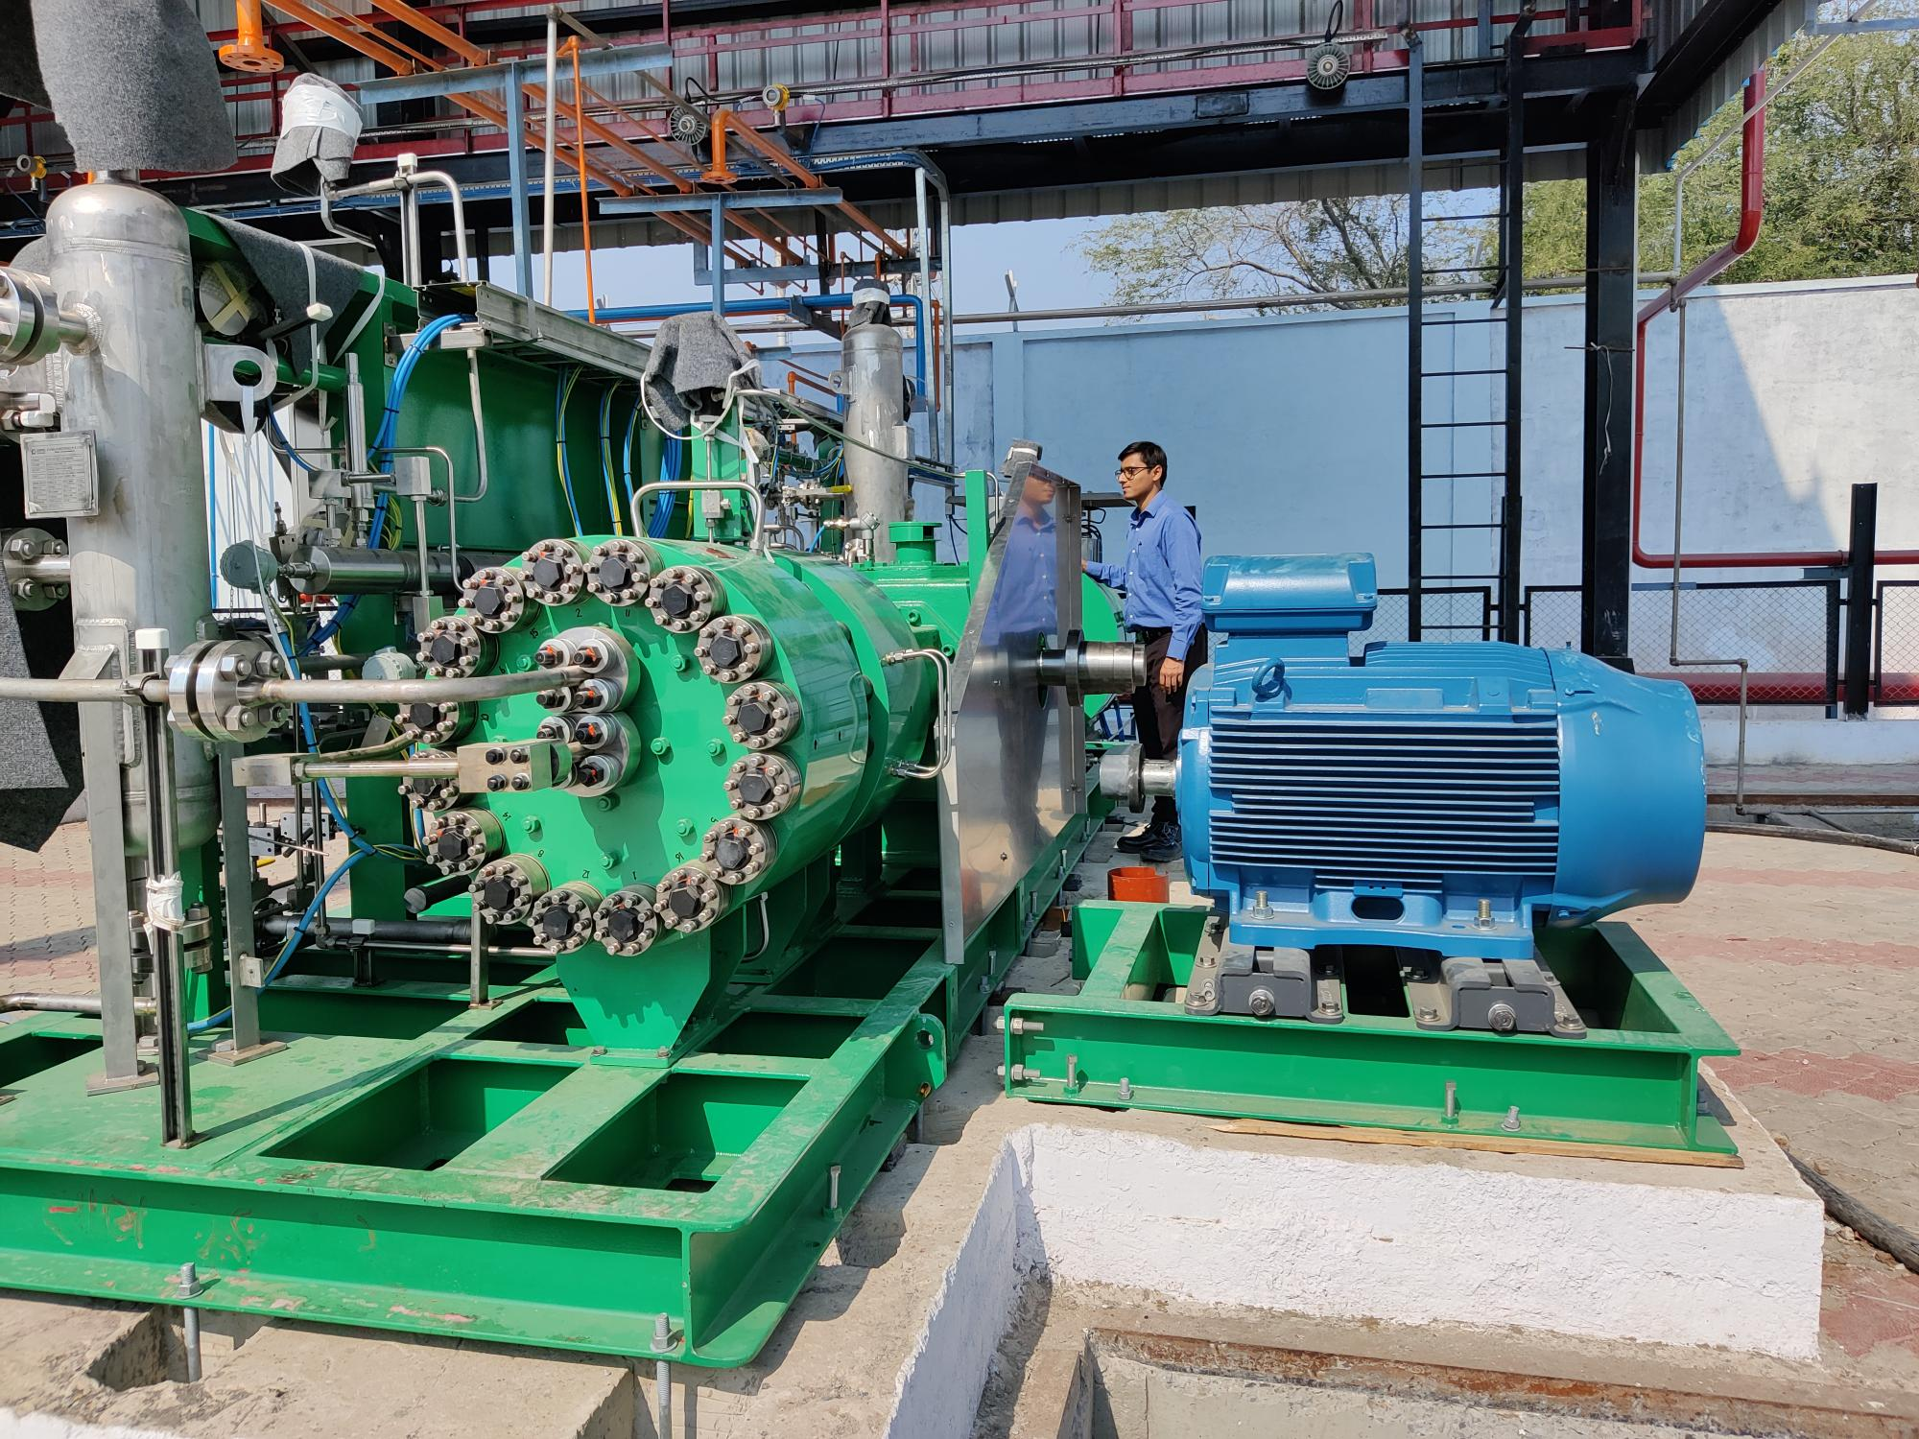
Hydrogen Recent Units
9 Series Hydrogen Package – Bus Refueling

Slide 18
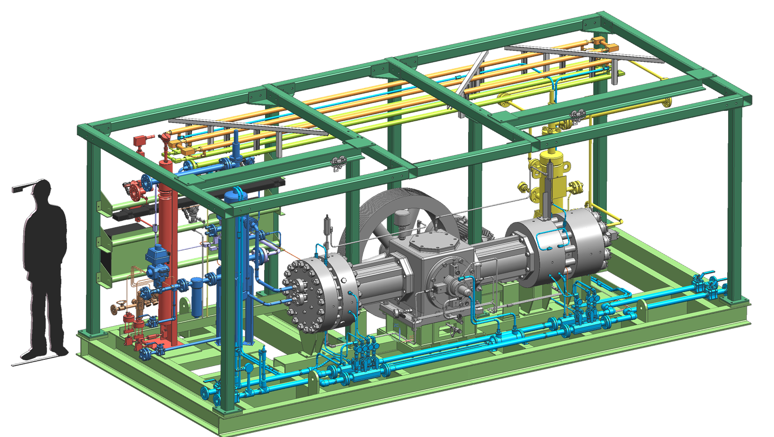
Standard Hydrogen Package design for shorter lead-times
Flywheel
Process Coolers
Dampener
Dampeners
Gas Inlet
Head #2
Gas Outlet
Head #1
Crankcase
Filter

Slide 19
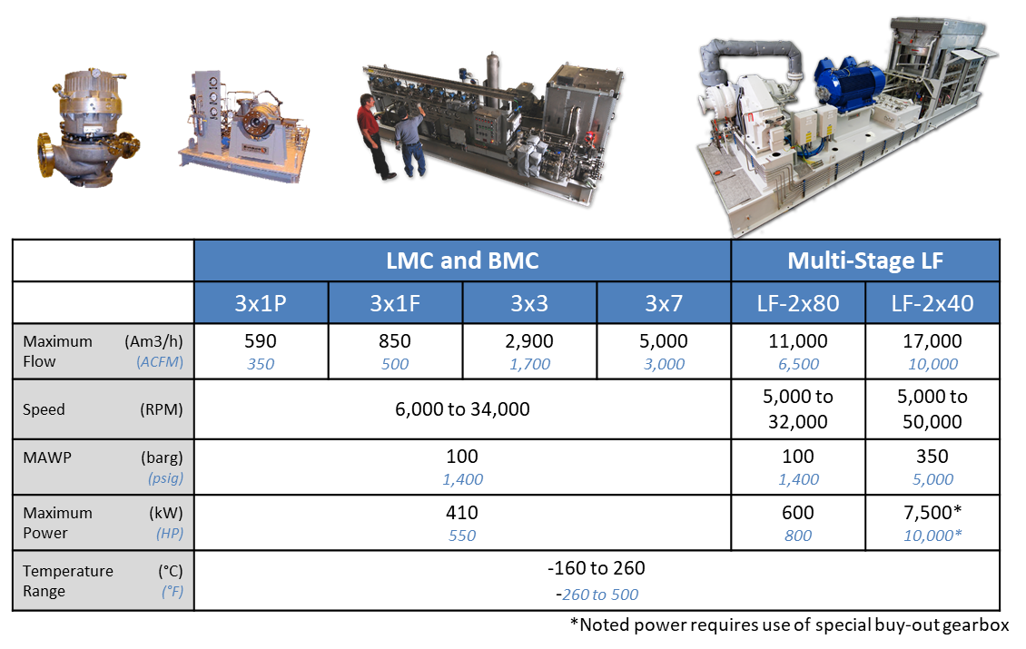
Sundyne Centrifugal Compressors

Slide 20
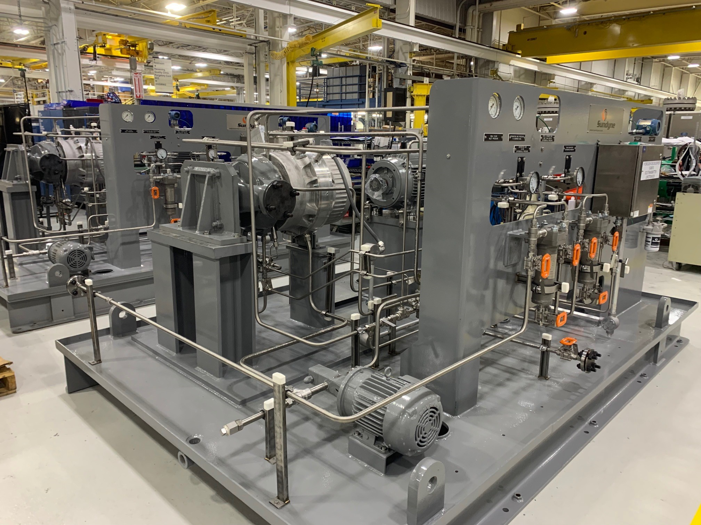
“BMC” H2 Drying Compressor Package

Slide 21
Summary
Sundyne has a broad product portfolio to support Hydrogen & CCUS applications.
PPI Diaphragm Compressors:
- Product purity (No contamination of process gas)
- Absolutely no leakage to atmosphere (Environmental safety)
- Non-contaminating gas compression (high CR)
API Centrifugal Compressors:
  - Single gearbox to provide 1-6 stages
  - Pulsation and vibration free operation
  - Meets API standards
Sealless Pumps (ANSIMAG & HMD Kontro):
  - Zero Leakage
  - Small footprint
  - Magnetic drive
API 610 & 685 Centrifugal Pumps:
- Single stage (direct drive)
- Compact design
- Multiple seal arrangements (single, double, tandem, API 682 cartridge seal)
High reliability across all our equipment for critical to success applications
Global support network ready to service our machines.
Compliance with worldwide codes and standards

Slide 22
Thank You

Slide 23
45V Hydrogen Production Tax Credit
The Inflation Reduction Act (IRA) provides for a
45V hydrogen Production Tax Credit (PTC)
  Up to $3 credit per kg of hydrogen produced
  For projects with a lifecycle greenhouse gas emissions intensity less than
  0.45 kg CO2e per kg H2
The Department of the Treasury is tasked with writing guidance on how the tax credits will be implemented
  To define how hydrogen generation using Clean electricity qualifies for the credit
Various groups are proposing constraints which could severly limit access to the credits by most hydrogen generators.

Slide 24
45V PTC Proposed Qualification Constraints
Temporal Matching – Require hydrogen producers to match their consumption of electricity from the grid with clean electricity production on an hourly basis
Additionality – Only using renewable electricity production that has been recently installed and
Deliverability – That renewable electricity production must be nearby the hydrogen facility
Clearly Impossible (and Unnecessary) Criteria for All But A Handful of Projects
Effectively Canceling the IRA 45V Credits

Slide 25
The Issues – Hourly Matching
Nothing is gained by measuring energy produced and energy used on an interval this brief, in fact, data will be lost (following slides)
If hourly matching is adopted, a majority of hydrogen generators will not be able to access the tax credit
  Most hydrogen generators will need to operate continuously in order to achieve an adequate Return on Investment in their costly capital equipment
  But renewable energy sources such as wind and solar produce energy intermittently
  Therefore although the renewable source and hydrogen generator are producing and using exactly the same amount of energy during a billing interval, it often won’t be simultaneous
This constraint shows a lack of understanding of how energy works

Slide 26
The Issues – Additionality “Recently Installed”
Intended to avoid diverting renewable energy already being supplied to the grid over to hydrogen generation
Seems out-of-scope to dictate to renewable energy suppliers who they can and can’t sell their electricity to
Unintended consequence examples
  A solar array is supplying electricity to a hydrogen generator and that generator goes out of business
    That solar array would then like to supply energy to a new hydrogen generator but would be prevented from doing so by this rule.
  Using a nuclear power plant to supply energy to a hydrogen generator
    They would be prevented from doing so because the nuclear power plant is not a “new” source of energy .

Slide 27
The Issues - Deliverability
“Energy production nearby the hydrogen facility”
  The energy generator and the energy user should be connected to the same grid so there is an electrical path for the energy
  However, wording is vague and unclear
  Recommend that the wording be changed to “Energy production and hydrogen facility have connection via electrical grid”.

Slide 28
Understanding How Energy Works
It takes electric ENERGY (power over time) to produce hydrogen
Electrical energy is defined as Power times Time
  Power has the units of Watts, and time has the units of hours
  Therefore, the unit of Energy is the Watt-hour
It’s extremely important to make the mental distinction between power and ENERGY
  Power is instantaneous
  Energy is power over time (Watt-hours)
We are tracking renewable Energy not Power

Slide 29
Understanding Energy
Because ENERGY has a time element, it becomes a commodity,
it’s quantifiable, it has a value and exchangeable
  Energy can be embodied in molecules
    Hydrogen
  Energy can be consumed
  Energy generation may have created emissions
  Quantities of energy can be exchanged
    In time or place
This is Why Energy Production and Energy Use DO NOT Have to be Simultaneous
And Why “hourly matching” is Not Necessary

Slide 30



Energy Exchange Example
Electric
Grid
300 GWh per Month
300 GWh per Month
Various
Loads
Utility
Power Plant

Slide 31

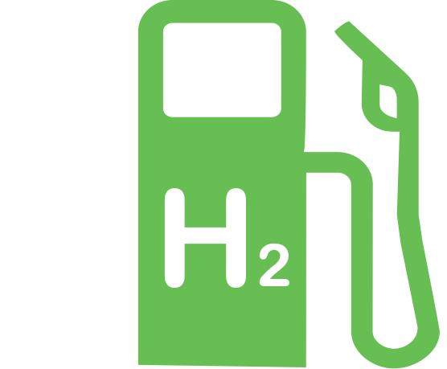
Grid Adding Renewable Source and Hydrogen Load
Electric
Grid
30 GWh per Month
30 GWh per Month
(Or 1 GWh per day)
(Or 1 GWh per day)
300 GWh per Month
300 GWh per Month
Various
Loads
(Or 10 GWh per day)
(Or 10 GWh per day)
Utility
Power Plant

Slide 32
One Day That Month Without Hydrogen Load
Electric
Grid
1 GWh
9 GWh
10 GWh
Various
Loads
Utility
Power Plant
Reduction in
non-renewable

Slide 33
One Day That Month Without Renewable Source
Electric
Grid
1 GWh
11 GWh
10 GWh
Various
Loads
Utility
Power Plant
9 GWh for one day
11 GWh for one day
An exchange of energy in time

Slide 34
Net Result (Energy Exchange)
When renewable energy exceeds hydrogen load
  Non-renewable energy is decreased (to keep grid balanced)
When hydrogen load exceeds renewable energy
  Non-renewable energy is increased (to keep the grid balanced)
When renewable energy and hydrogen load equal for the billing interval
  No net non-renewable energy is used
  (than would have been without use of the grid for hydrogen energy transfer)
This is why “hourly matching” is completely unnecessary
  Renewable energy source and paired hydrogen load don’t have to operate synchronously during a billing interval
Billing Interval length is arbitrary
  Energy is commonly billed monthly, so monthly is a good interval.
Energy
Exchanged
In Time

Slide 35
Example 2 - Grid Energy (Watt-hours) Over Time
Area X: Carbon positive
Area Y: Carbon negative
When X = Y: Carbon neutral and Renewable energy = Energy for H₂ Generation
Electric meters provide total Energy (Watt-hours) for Source and Load for billing period
  Only Renewable energy that equals energy for H₂ generation (for the billing period)
  qualifies for tax credit

Slide 36
Last Element of Energy Tracking
How do we know the energy from the renewable source only went to the hydrogen load (not double-sold)?
Determined through a contract between the Renewable Source and Hydrogen Load
  Power Purchase Agreement (PPA) or Renewable Energy Contract (REC)
  Attests that the energy is only being sold to one user
  Defines the energy quantity
  Energy quantity is verified by electric meters at source and load.

Slide 37
A Better Approach to Energy Tracking
Four Criteria
  Energy Contract between renewable energy source and hydrogen generator
  Electric metering at source and load
  Data is collected during a billing interval (month, quarter, etc)
  Source and load are connected to the same electrical grid
Benefits
  Assures renewable energy for hydrogen generation is accurately tracked
  to qualify for the Production Tax Credit
  Achievable for hydrogen generators
Covered on the latest HydrogenNowCast Episode 75.

Slide 38
Responding to Treasury Department
CHN has responded with a White Paper
  Posted on CHN website at: https://www.colorado-hydrogen.org/resources
  Click on “A Better Alternative to Hourly Matching.pdf”
The public can respond here:
  https://www.irs.gov/newsroom
  Then search for “2022-58”
  Then select “IRS seeks comments on upcoming energy guidance”.

Slide 39

Introducing New Volunteer Staff
Bryant Beeler
BS electrical engineering
MS Space systems engineering
Advanced technologist and commercialization
Focused on increasing hydrogen market traction, adoption, and user base
Toyota/Shell hydrogen refuel finalist
Years of experience devolving and integrating advanced technologies and emergent capabilities
Grant search and proposal writing
Data analysis

Slide 40
CHN 2.0 Initiatives
Grant applications
  CHN is offering to assist or lead grant applications
    DoE, DOT, private foundations
  For various hydrogen initiatives
    Public polling data
    Research topics
    Etc
  Seeking suggestions from CHN Stakeholders
Open house events
  Hosted at a Colorado hydrogen company, university or lab
  Open to CHN Stakeholders
  Company tour followed by social (on premises or local pub)
  Seeking offers to host from local companies.

Slide 41

Ontario Canada’s First H₂ Fuel Station Planned
Located at Toronto-Pearson airport
Funded by $1M from Natural Resources Canada
Fuels both light and heavy-duty vehicles
Carlsun Energy will build, own and operate the station
Collaboration between Greater Toronto Airports Authority (GTAA) and Carlsun Energy
There are currently five retail hydrogen stations in Canada, four in British Columbia, and the fifth in Quebec
Notes:
https://www.newswire.ca/news-releases/toronto-pearson-airport-and-carlsun-energy-announce-ontario-s-first-public-hydrogen-refuelling-station-for-light-and-heavy-duty-vehicles-863427845.html

Slide 42
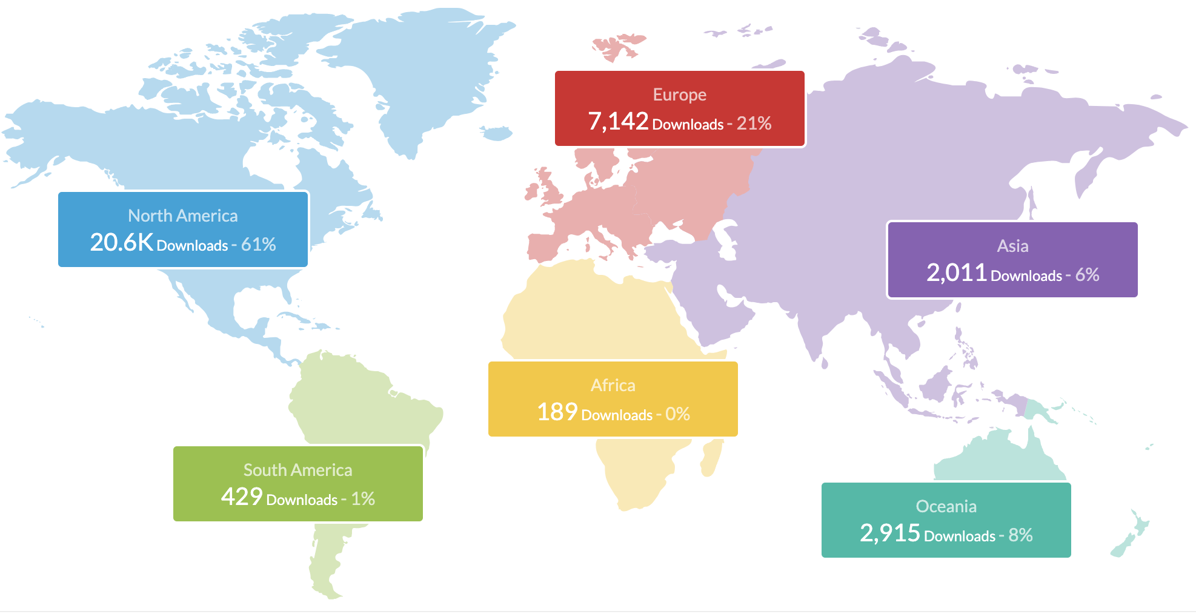
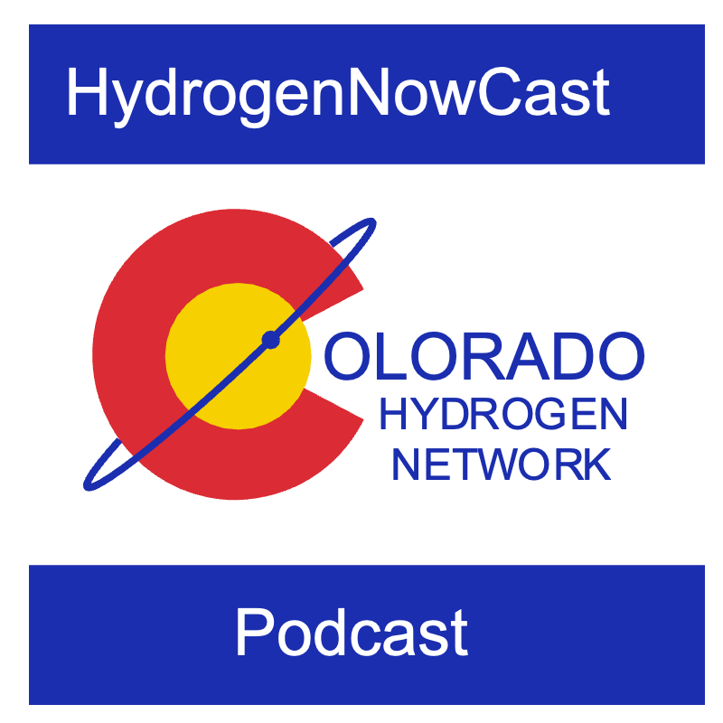

Podcast Update
The HydrogenNowCast
75 episodes, 33,315 downloads
Upcoming episodes
  H₂ for Aviation with Hysky.org
  Hydride H₂ storage with GKN
Everyone – Please subscribe and give us a rating!

Slide 43


